Slide 1
Pharmacy Management System

Slide 2
Importance of the Project
The importance of the Pharmacy Management System lies in improving workflow efficiency within the pharmacy through the automation of daily operations. The system reduces human errors in data entry, medication dispensing, and inventory management. It enables accurate inventory control by monitoring expiration dates, stock quantities, and automated alerts. In addition, it enhances customer experience by providing faster service and reliable information. The system generates analytical reports that support effective decision-making, strengthens data security through Role-Based Access Control (RBAC) and Audit Logs, and supports future expansion and integration between multiple pharmacy branches. Furthermore, it ensures compliance with pharmaceutical regulations, such as preventing the sale of expired medications, and helps increase profitability through better management of purchasing and sales processes.

Slide 3
MAIN OBJECTIVE OF PROJECT
The main objective of the Pharmacy Management System is to develop a comprehensive and integrated solution for managing pharmacy operations efficiently. The system automates daily tasks such as sales, purchasing, inventory management, and reporting, thereby improving operational efficiency and reducing human errors. It supports decision-making through intelligent reporting and data analysis features. Additionally, the system provides effective management of medications, suppliers, customers, pharmacists, invoices, and inventory records. To ensure data security and privacy, the system incorporates Role-Based Access Control (RBAC) and encryption mechanisms. Furthermore, it offers a user-friendly graphical interface developed using PyQt5, making the system easy to use and manage.

Slide 4
Problems Solved by the Project
Before implementing the Pharmacy Management System, pharmacies face several operational challenges. These include difficulties in accurately tracking inventory, such as expiration dates, stock quantities, and hazardous materials. Human errors frequently occur during sales transactions and inventory management processes. In addition, there is often a lack of clear reporting for sales and purchasing activities, making decision-making more difficult. Employee monitoring is also limited, particularly in managing work shifts, attendance records, and user permissions. Many pharmacies lack automated alert systems for hazardous drugs and drug interactions, as well as mechanisms for suggesting therapeutic alternatives when medications are unavailable. Furthermore, supplier and invoice management processes are often not integrated into a single system, and the absence of Audit Logs makes it difficult to monitor system activities and ensure accountability.

Slide 5
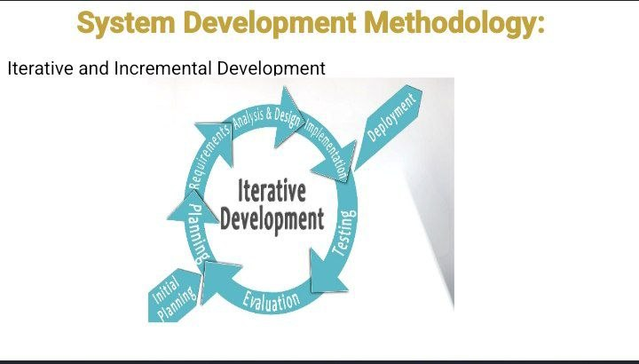
METHODOLOGY Used in the project

Slide 6
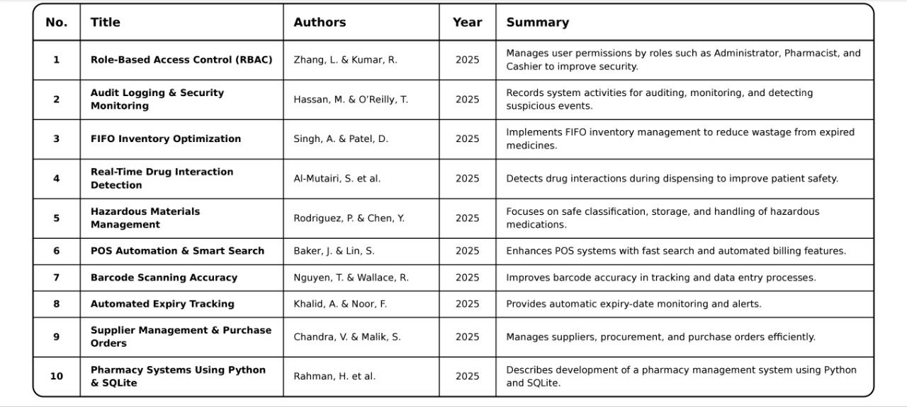
Research Papers

Slide 7
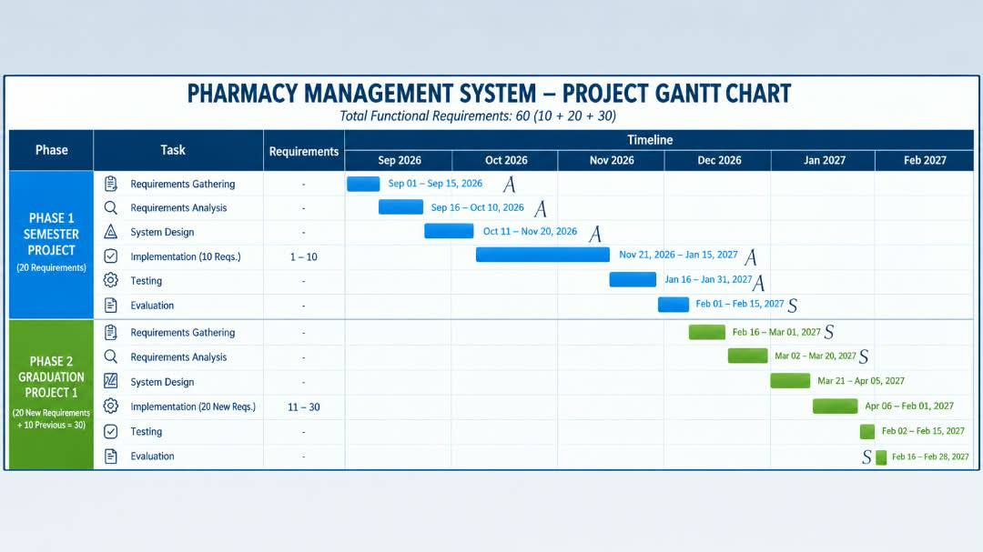
GANTT CHART

Slide 8
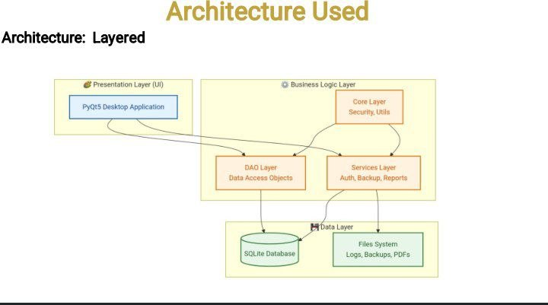

Slide 9
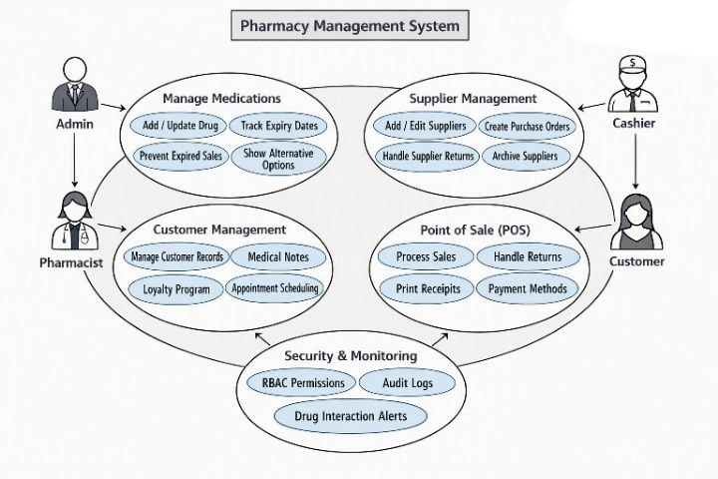

Slide 10
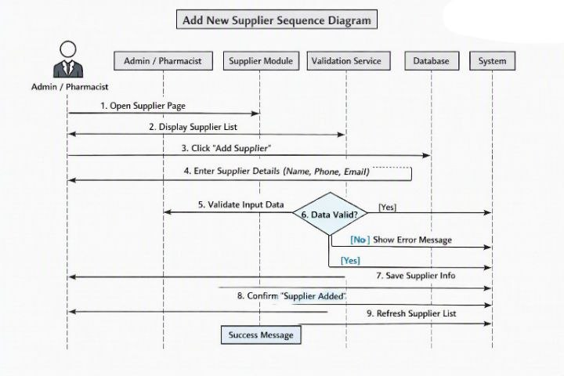

Slide 11
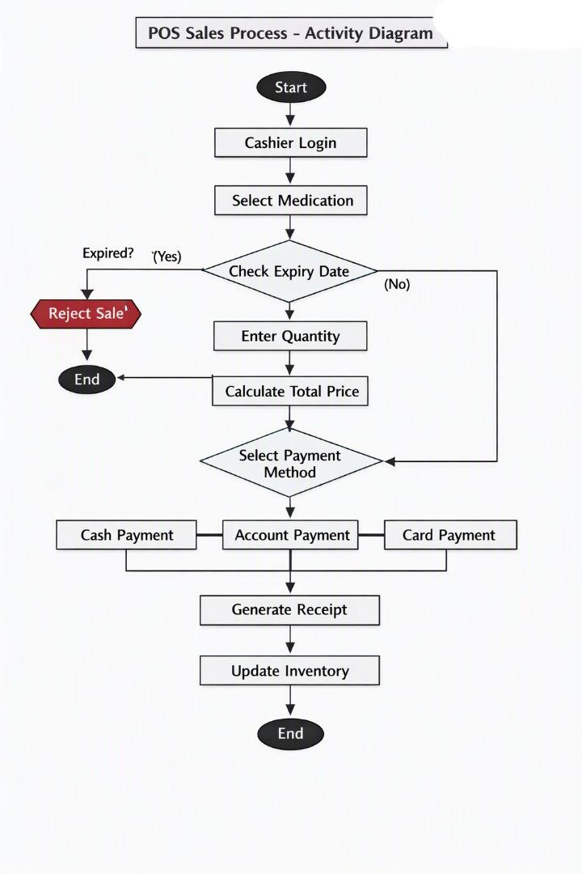

Slide 12
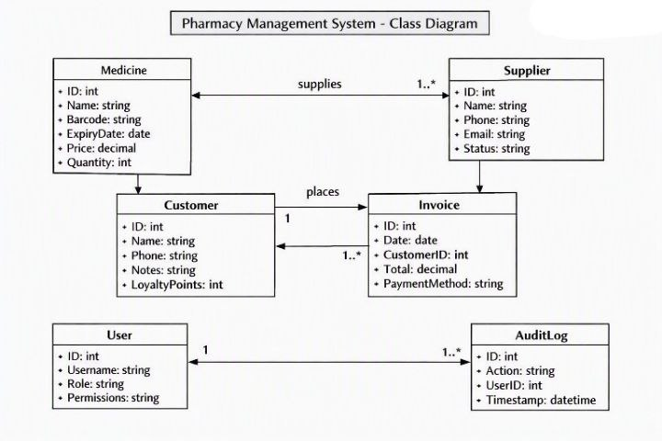

Slide 13
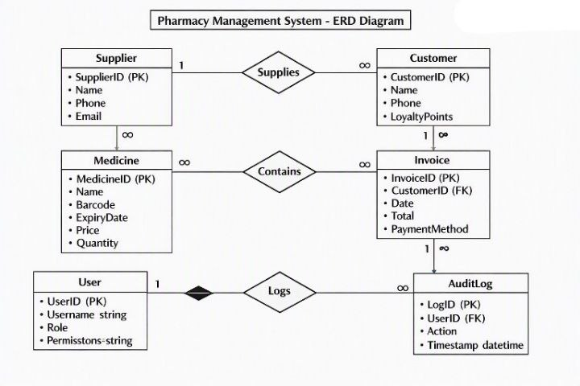

Slide 14

Languages, work environment and tools used

Slide 15


